Slide 1
Interfaces in Java
Abdul Haseeb

Slide 2
Introduction
Achieve complete abstraction
Specify what a class must do, but not how it does it.
Lack instance variables
May contain one or more abstract methods
A class implements one or more interfaces (Multiple Inhertitance)
An interface may extend another interface

Slide 3
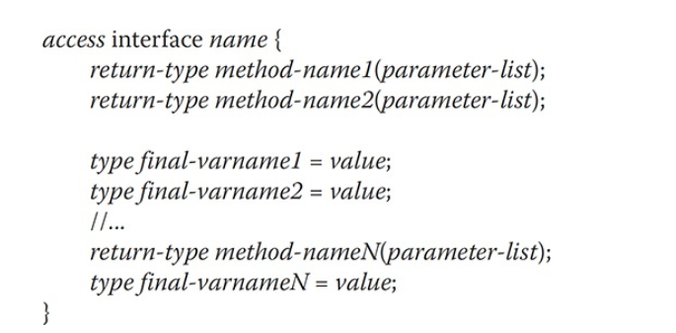
Syntax

Slide 4
Access Modifier with Interface
If you make the access modifier of interface public:
That interface should be the only public interface
File name should be same as the interface name

Slide 5
Methods and Variables in Interface
Variables are final and static, means implementing class can’t change them
All methods and variables are implicitly public

Slide 6
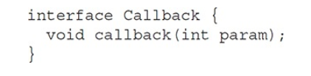
Interface Demo

Slide 7
Implements
A class can use interface by implementing it:
class circle implements shape{}
Override the area method by making it public
A class will work normally even after implementing interfaces

Slide 8
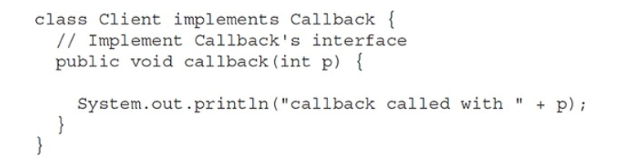
Implementing an Interface

Slide 9
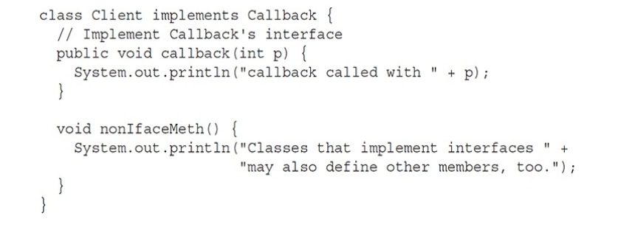
Normal for classes to have their own methods

Slide 10
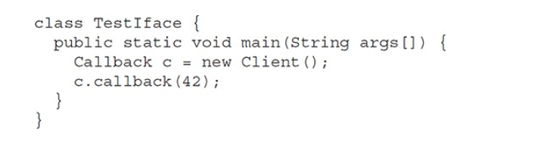
Creating an Interface reference and assigning it object of a class
Can only access those methods, which were declared in interface, because it has no knowledge of client methods!

Slide 11
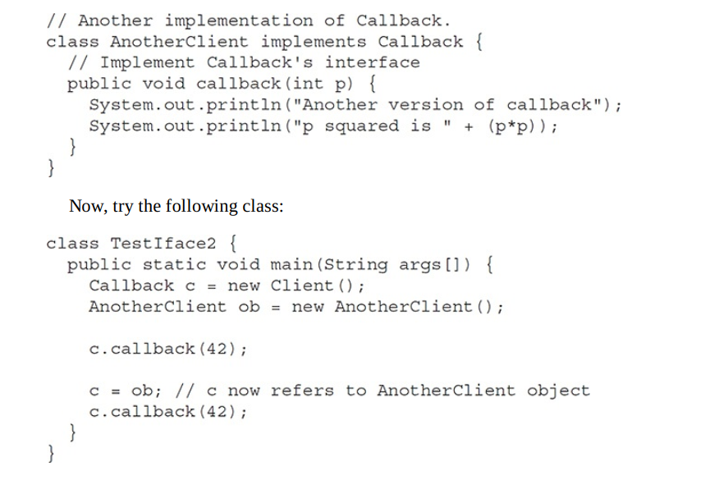
Call to a method is determined at run-time

Slide 12
Partial Implementations
If any class implements an interface:
It must override or provide complete implementation of all the abstract methods of interface
Otherwise make that class as abstract

Slide 13
Nested Interface
An Interface can be declared as a member of class or another interface
Nested or Member interface
When using nested interface:
Qualify it with the class name or interface name, which it is a part of

Slide 14
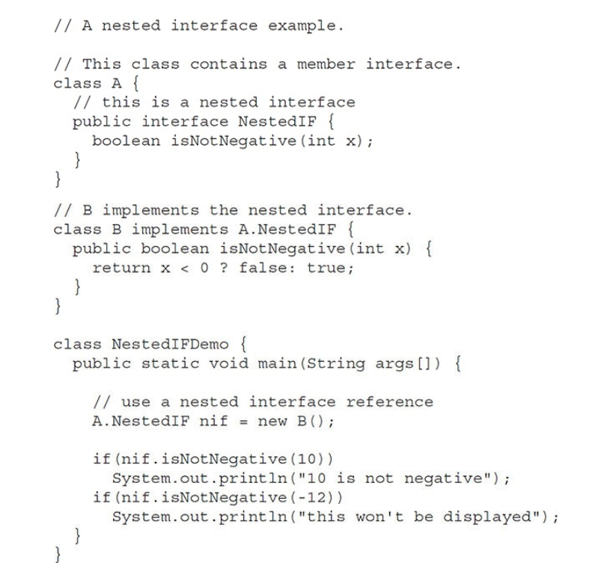

Slide 15
Assignment
Understand the stack example from book using Interfaces

Slide 16
Variables in Interface
If an interface has no any methods, but only the variables:
If class implements it:
All those variables are available as constants in Class scope

Slide 17

Implementing an Automated Decision Maker

Slide 18
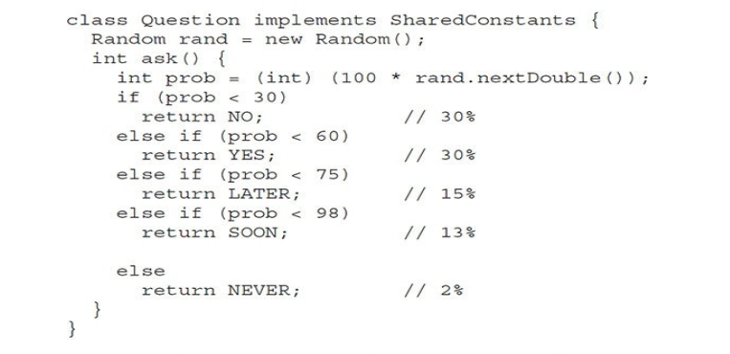

Slide 19
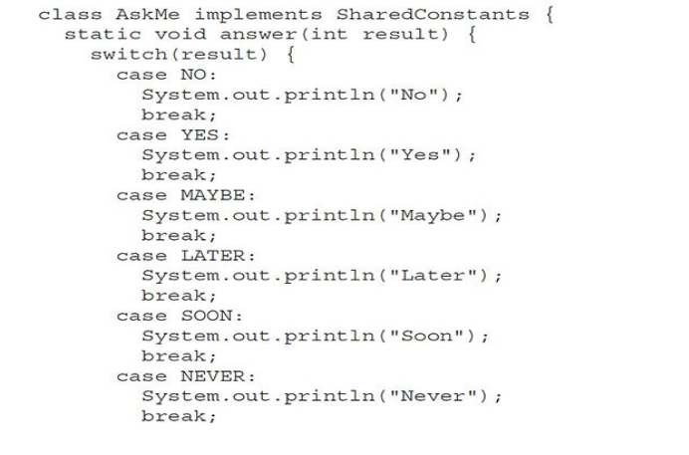

Slide 20


Slide 21
Inheritance in Interfaces
An Interface can extend another interface
A class that implements the extended version:
Must provide implementation of chain of interface methods
Code Example

Slide 22
Default Methods
Development in interfaces starting from JDK 8
Now you can add a default method:
A method with body (Non Abstract Method)
Advantage:
Without effecting implementation classes, Added Functionality is achieved
Even Implementation classes can override the concrete method of Interface

Slide 23
Declaring a default method
Only difference between a class method and default method is use of keyword default

Slide 24
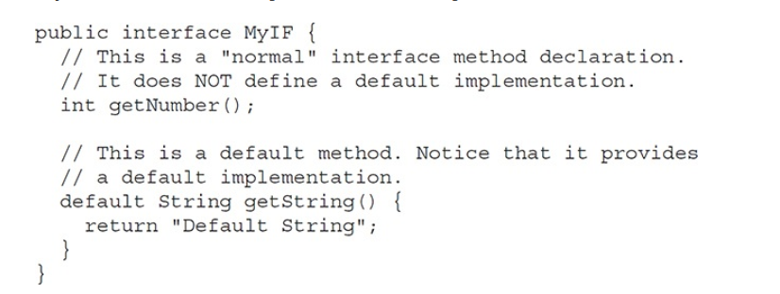
Default Method

Slide 25

Default Method

Slide 26
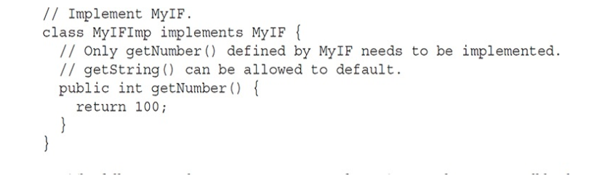

Slide 27
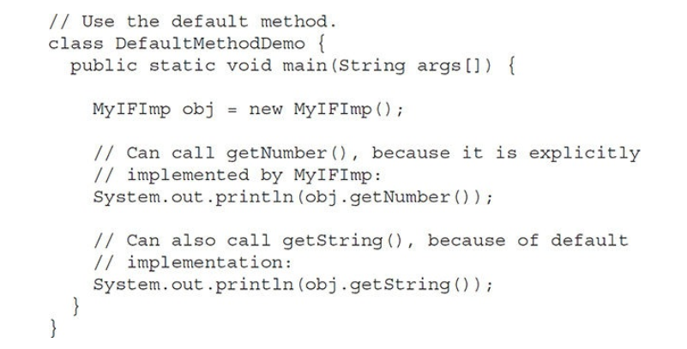

Slide 28
Is complete Abstraction lost because of Interfaces?
No
You still have to provide implementation class to use the default methods

Slide 29
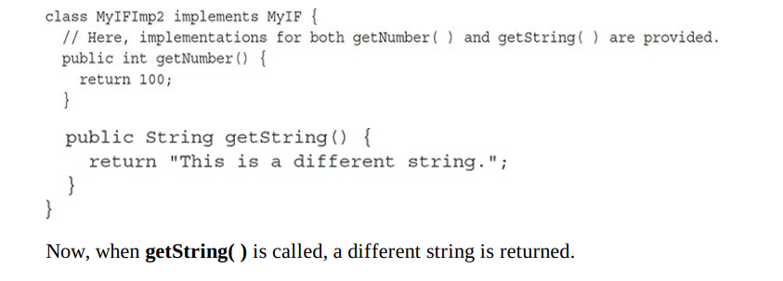
Overriding concrete method of Interface to achieve specific function

Slide 30
Multiple Inheritance
Java doesn’t support inheriting from multiple classes
But to some extent we can achieve it:
A class implements more than two interfaces

Slide 31
Multiple Inheritance Issues
Alpha and Beta Two Interfaces
Both have a default method call reset()
MyClass implements both Alpha and Beta
Which reset() will be called?
Error will occur
To avoid error, MyClass can override the reset() method and it will take preference (Class implementation takes priority)

Slide 32
Multiple Inheritance Issues
Beta extends Alpha, and both have a method reset()
Beta’s version will take preference
But what if implementation class overrides?

Slide 33
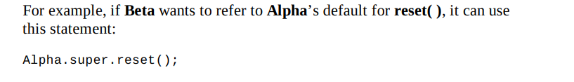

Slide 34
Use Static Methods in Interface
We can also add static methods to an interface, like we add them to the classes.
We can call them directly with Interface name

Slide 35
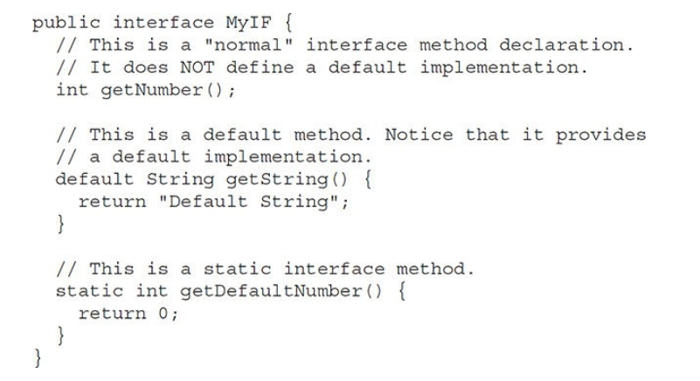

Slide 36
Private Method
You can also add a private method to interface, from JDK9
It can be accessed by default method of same interface or private method of same interface

